Slide 1
LAND USE OPTIONS
VW – CHIQUITA LAND SWAP
CHIQUITA PARKING
NEW WAREHOUSE LOCATIONS

Slide 2
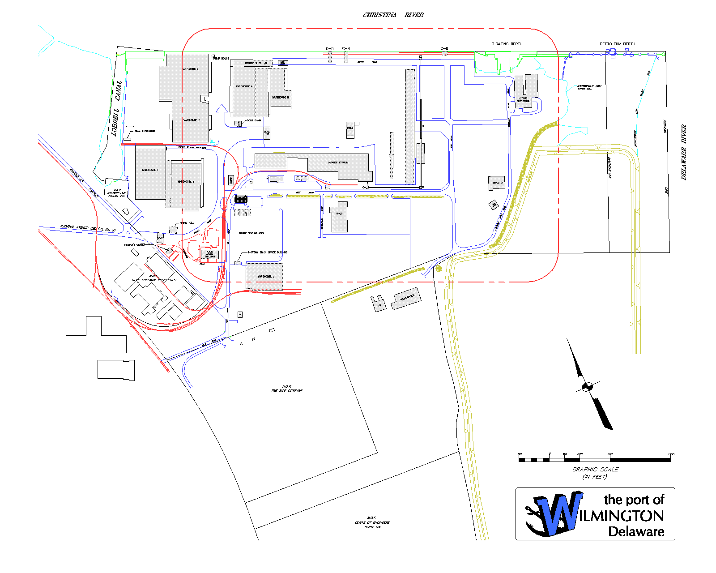
SITE PLAN
EXISTING CONDITIONS
Enlarged Plan Area
Notes:
ENLARGED PLAN AREA

Slide 3
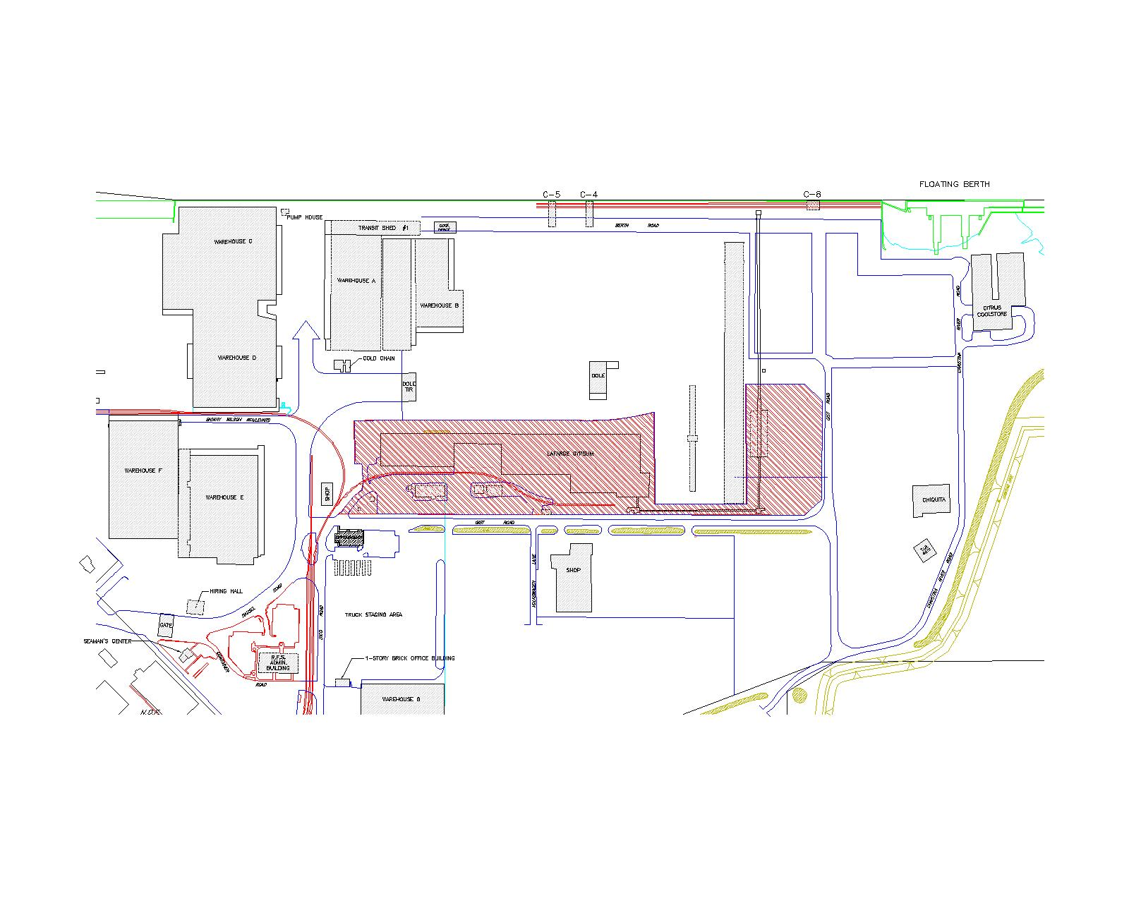
SITE PLAN
EXISTING LAFARGE LEASE
Existing Lafarge Lease Area

Slide 4
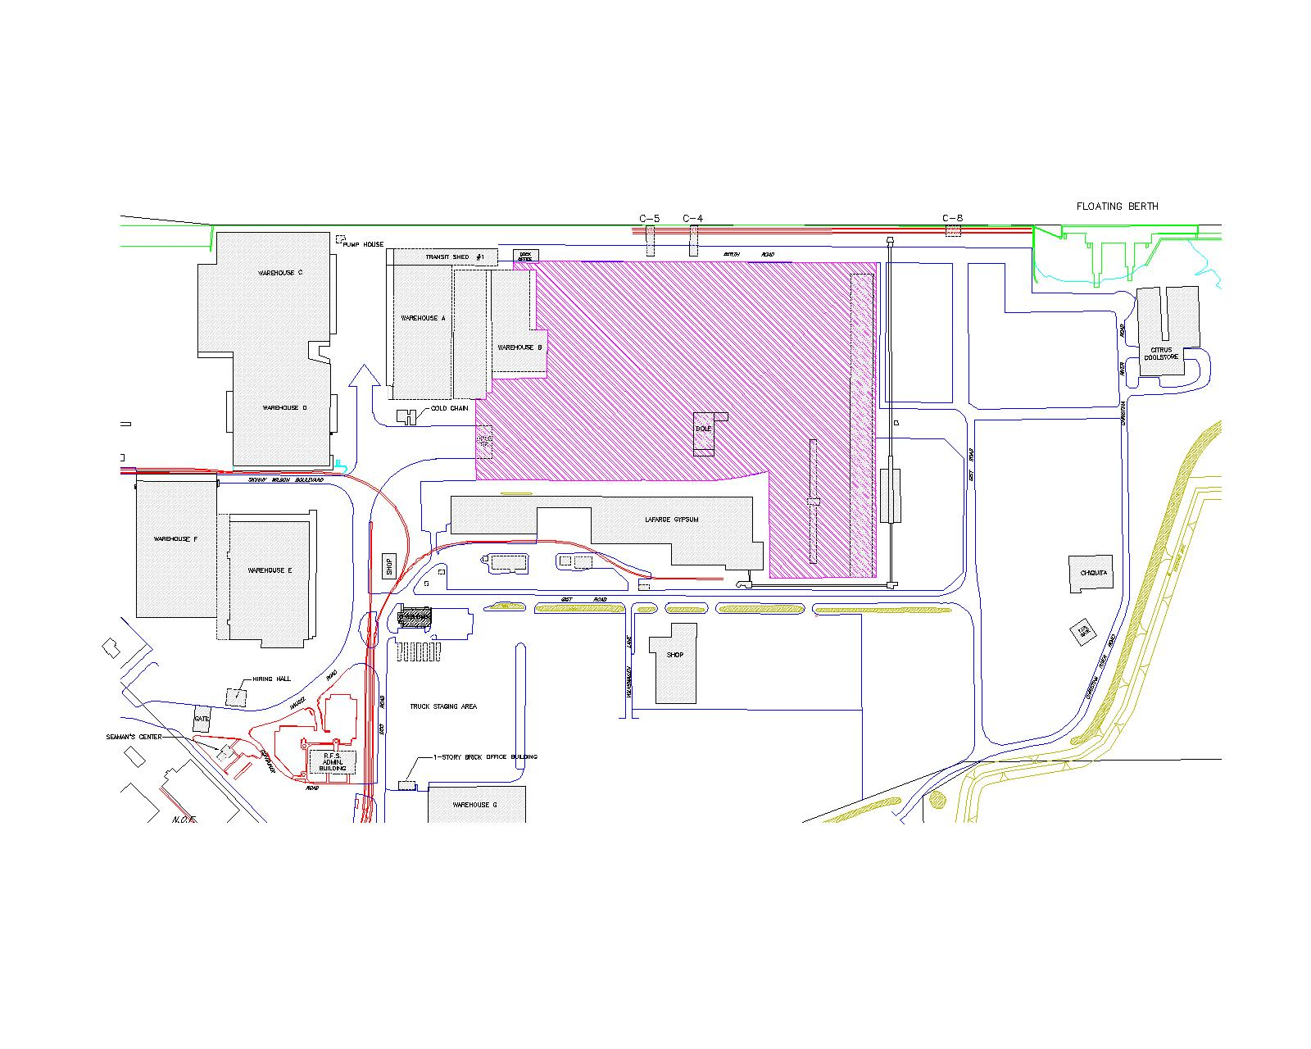
SITE PLAN
EXISTING DOLE LEASE
Existing Dole Lease Area

Slide 5
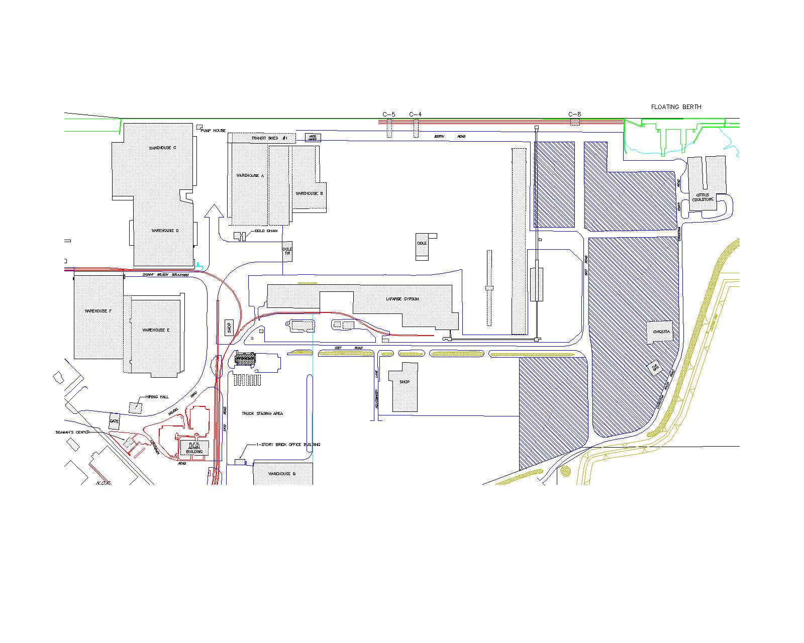
SITE PLAN
EXISTING CHAQUITA LEASE
Existing Chiquita Lease Area

Slide 6
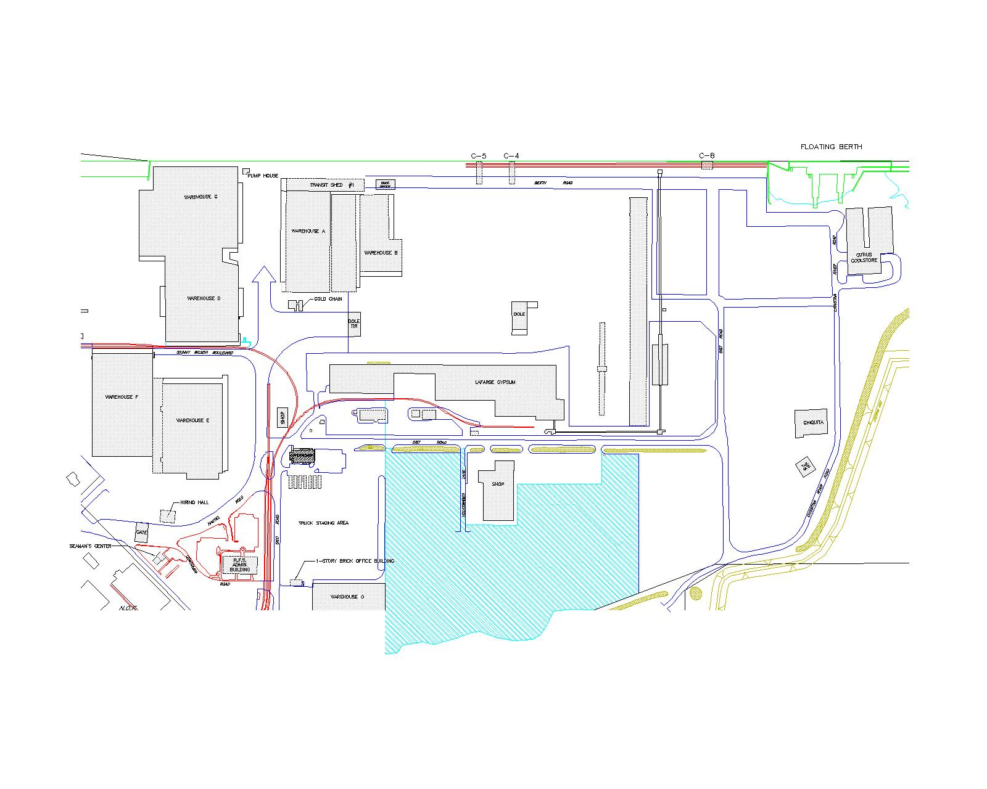
SITE PLAN
VOLKSWAGEN LEASE
Existing VW Lease Area

Slide 7
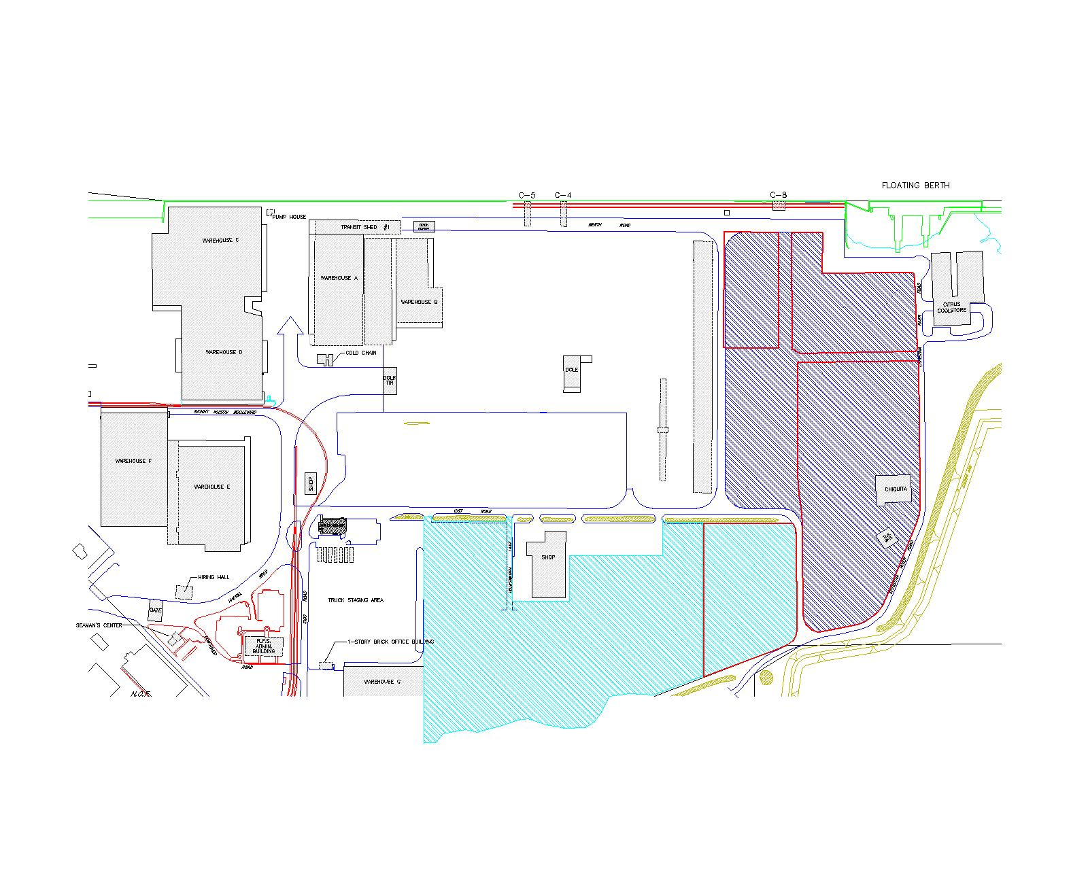
SITE PLAN
RESIVED CHIQUITA & VOLKSWAGEN LEASES
Existing Chiquita Lease Area (Typ.)
Proposed VW Lease Area
Proposed Chiquita Lease Area

Slide 8
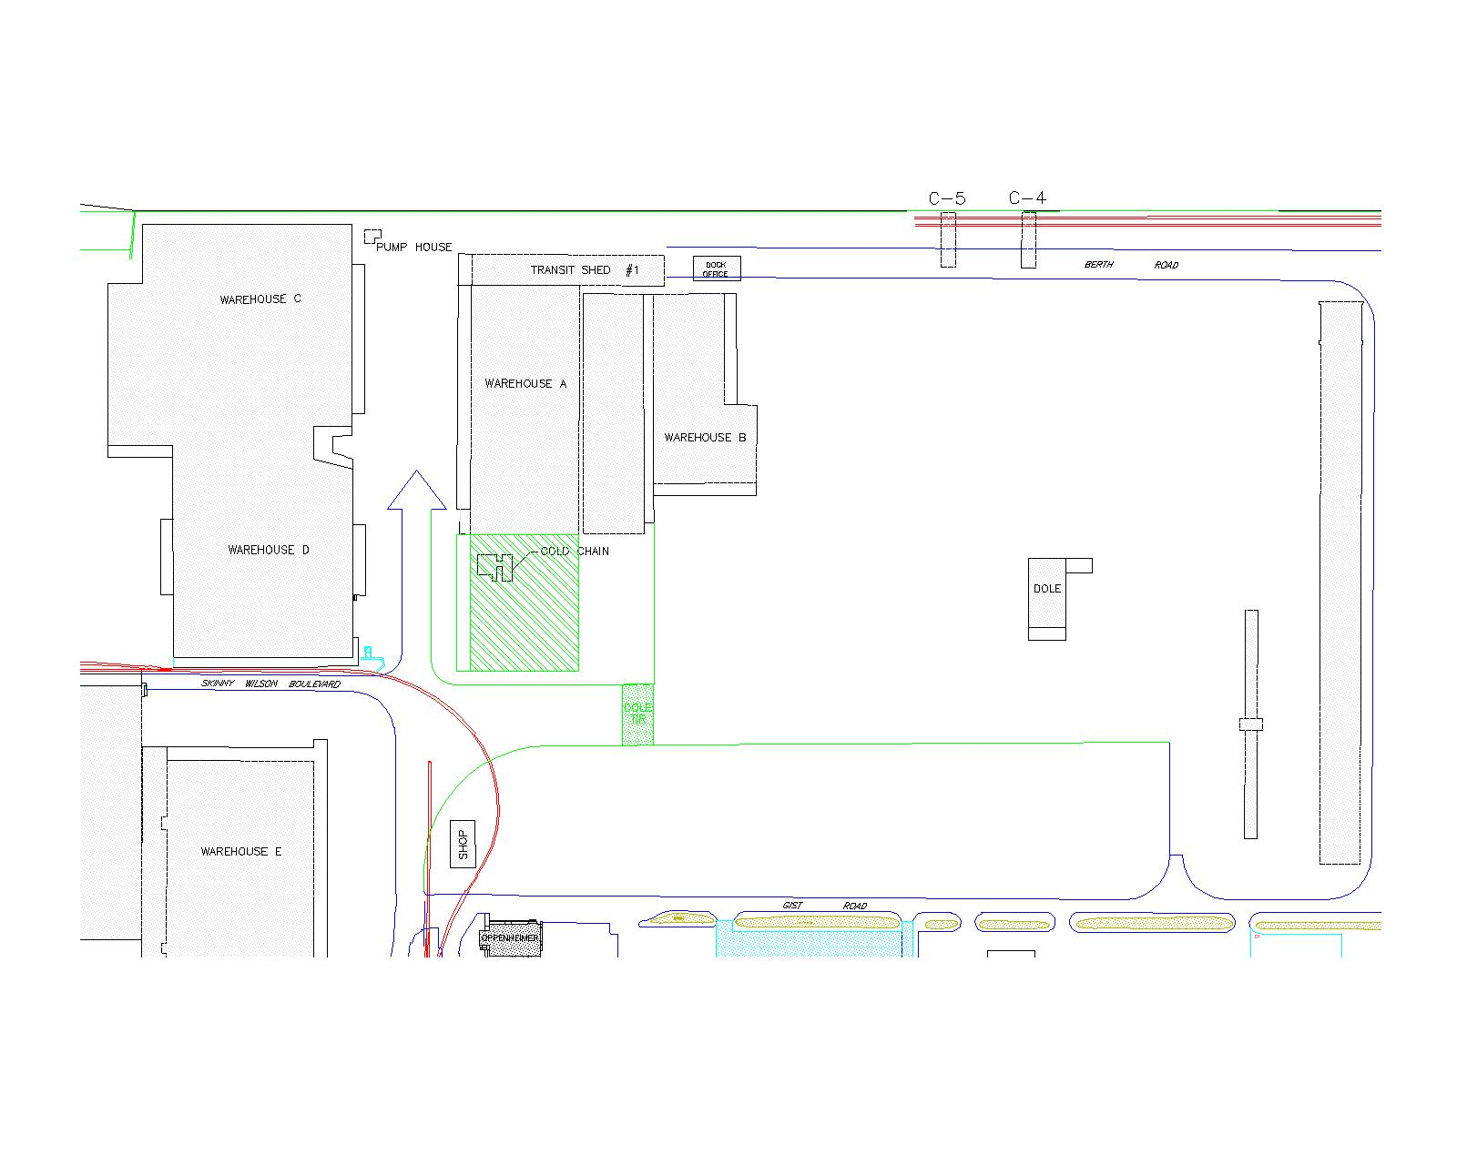
SITE PLAN
WAREHOUSE OPTION 1
60,000 SF attached to Warehouse A
Relocated TIR Gate

Slide 9
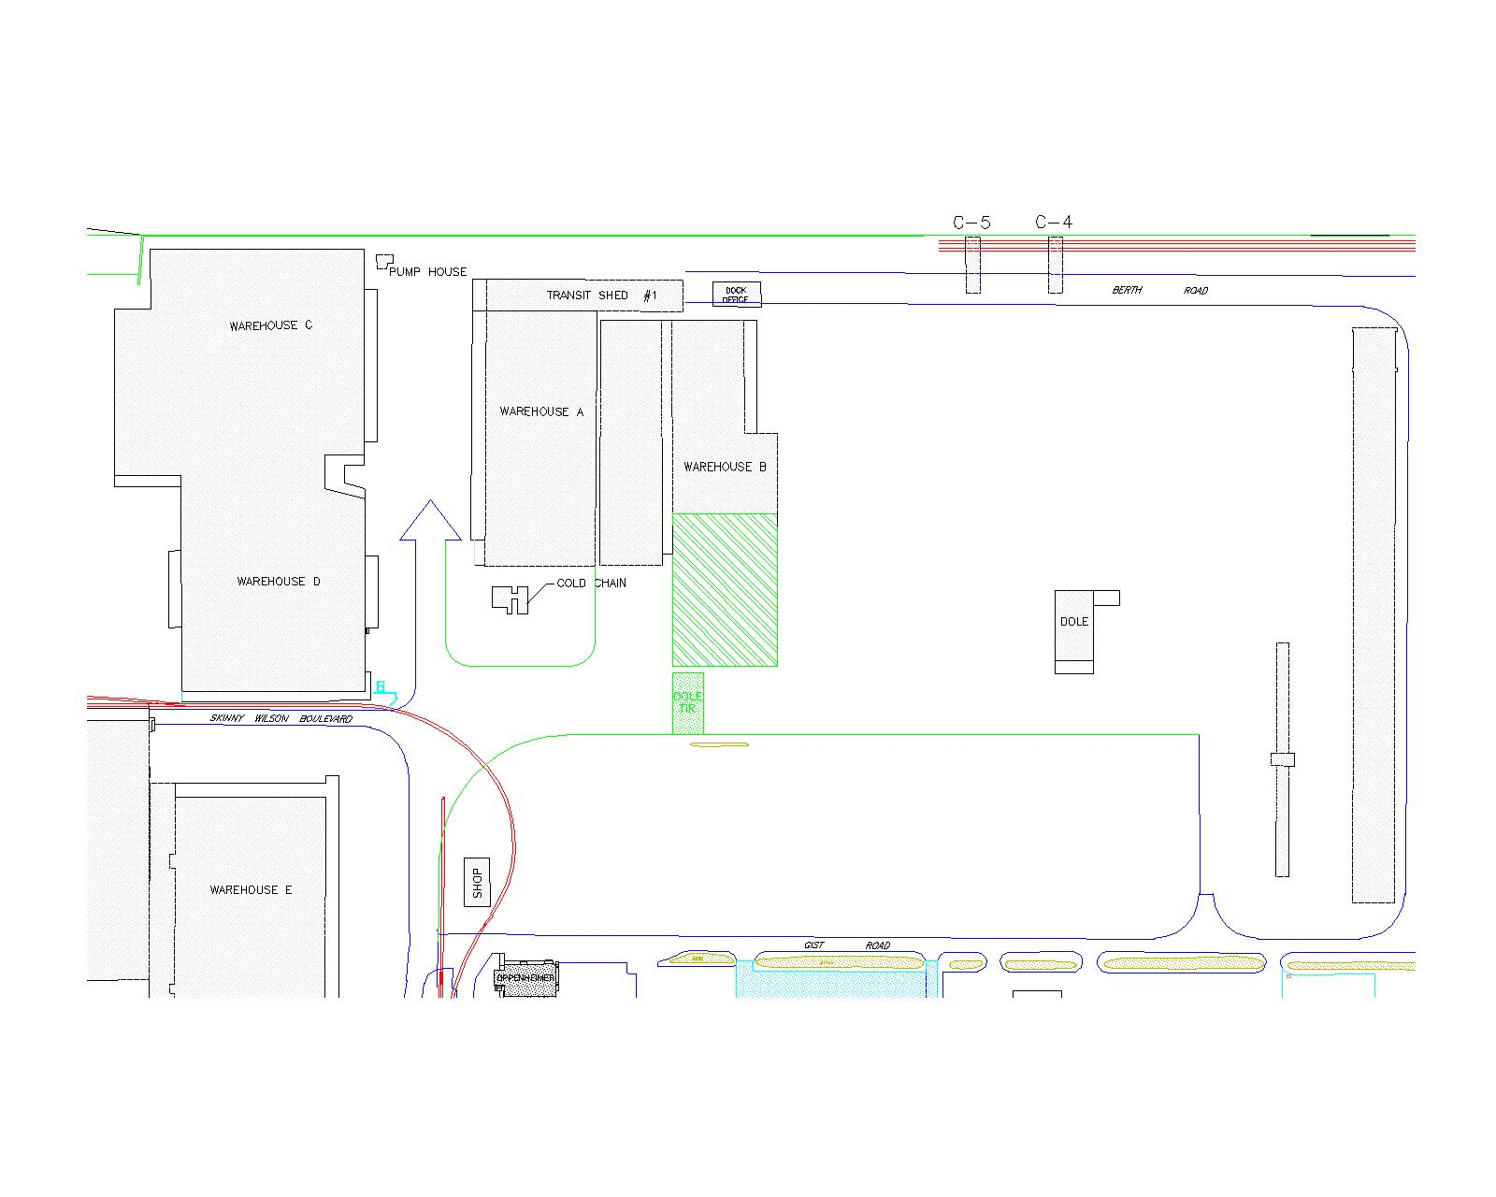
SITE PLAN
WAREHOUSE OPTION 2
60,000 SF attached to Warehouse B
Relocated TIR Gate

Slide 10
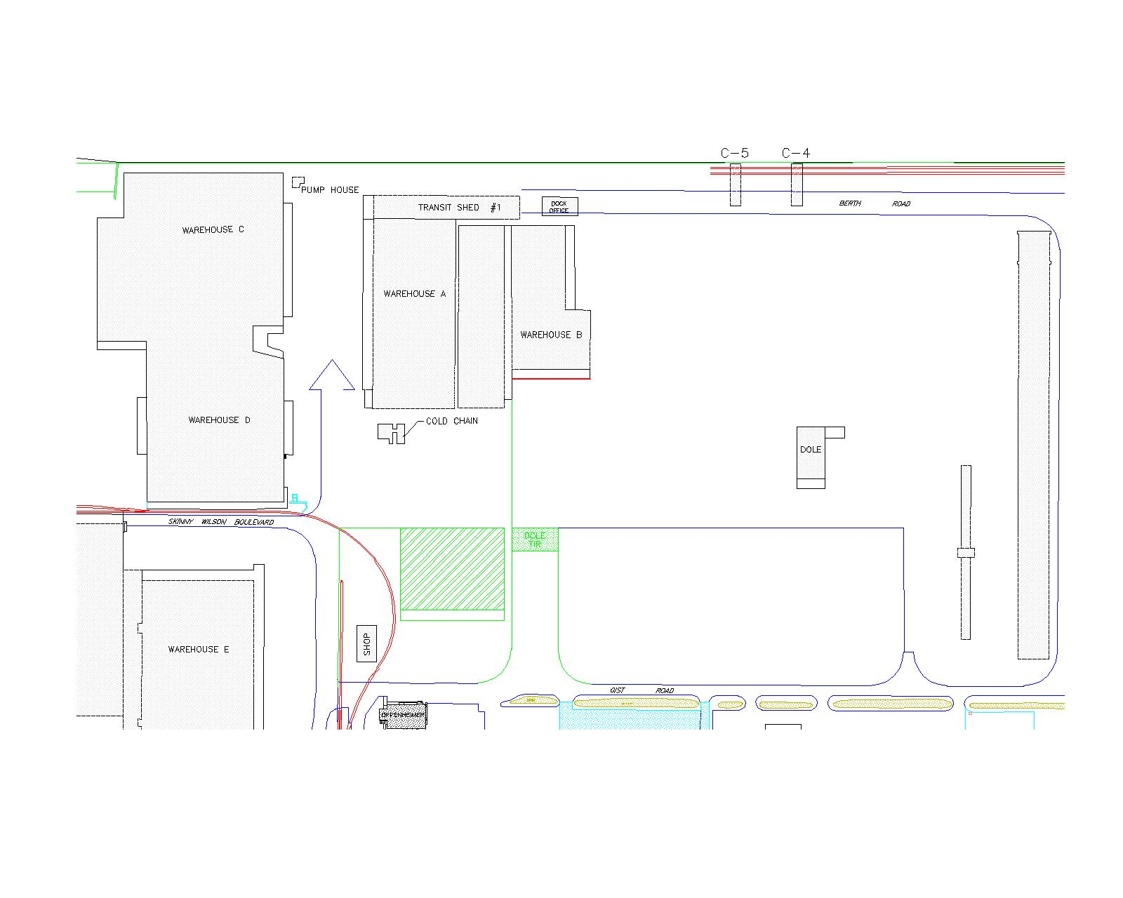
SITE PLAN
WAREHOUSE OPTION 3
Relocated TIR Gate
60,000 SF Freestanding

